Slide 1

Analysis presentation
Kiera Harris

Slide 2
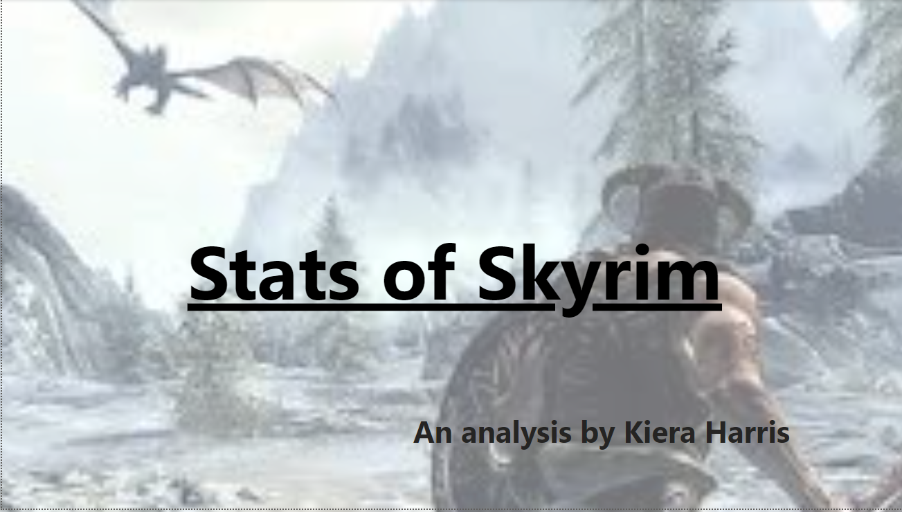

Introduction
With PowerPoint, you can create presentations and share your work with others, wherever they are. Type the text you want here to get started. You can also add images, art, and videos on this template. Save to OneDrive and access your presentations from your computer, tablet, or phone.
All Datasets obtained from Kaggle (https://www.kaggle.com/)

Slide 3

Agenda
Summarising in Pandas
Cleaning the data in Excel
Loading to PowerBI
Questions I wanted to answer
Visualisations
Further analysis
Conclusion

Slide 4
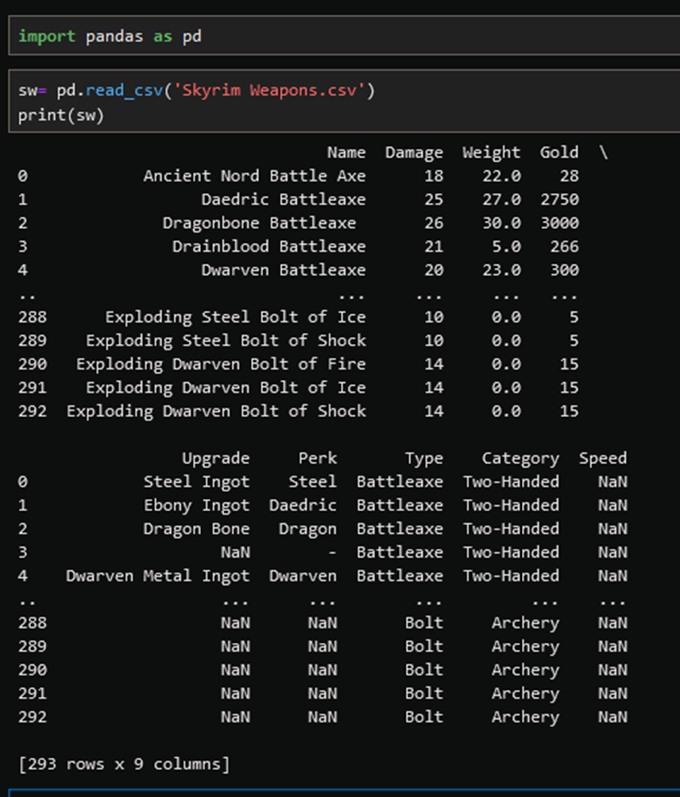
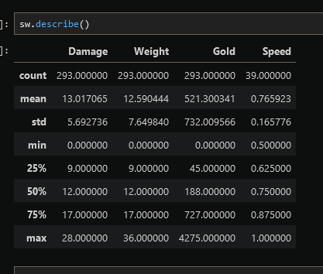
Getting an overview of the data
In Python using Pandas

Slide 5
Cleaning the data
Using Excel’s Power Query Editor

Slide 6
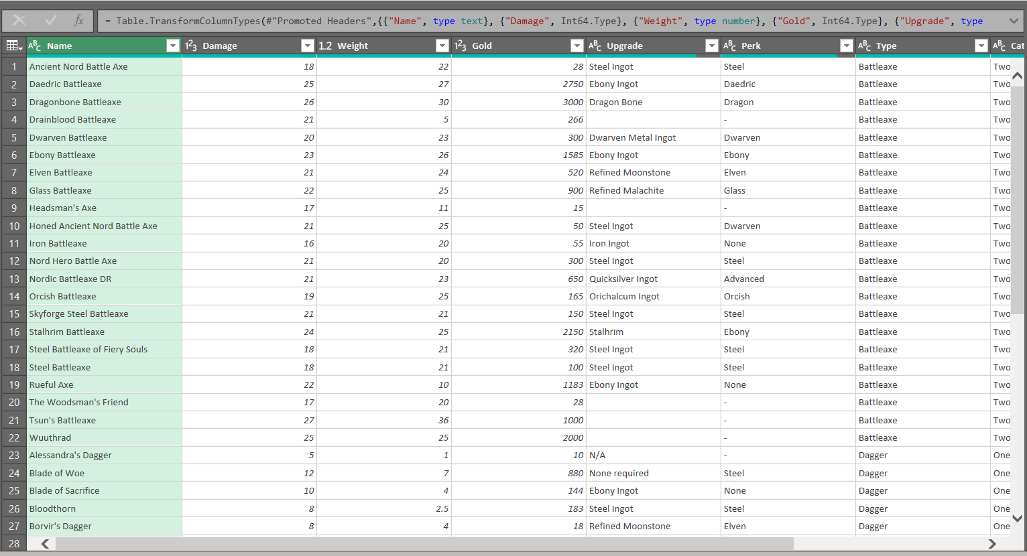
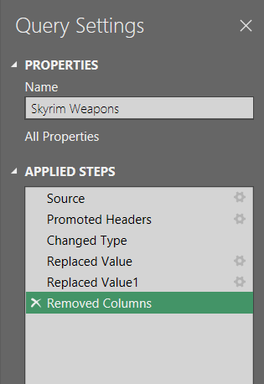
Chart

Slide 7
Loading dataset to power bi

Slide 8
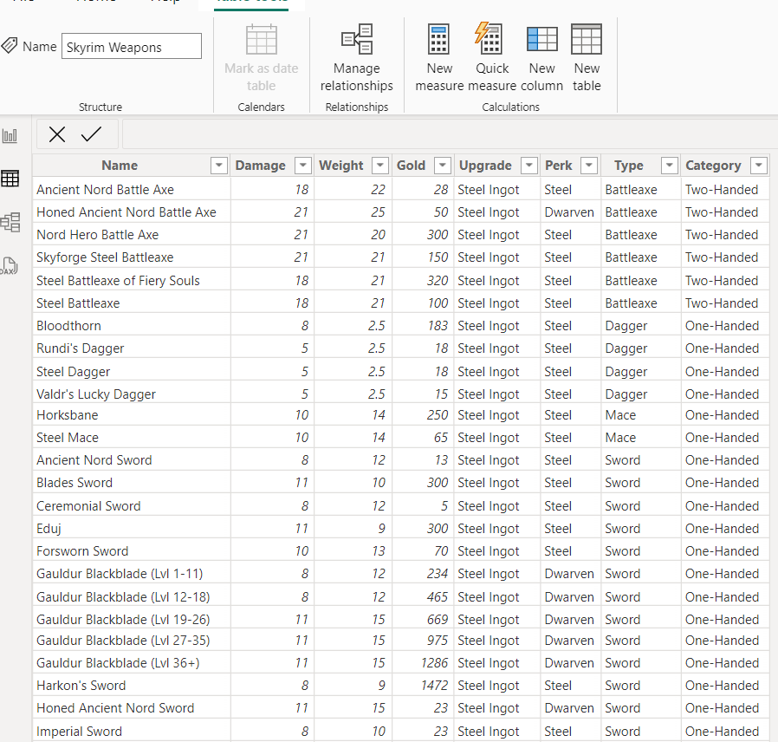

Slide 9
Creating visualisations
Using PowerBI

Slide 10
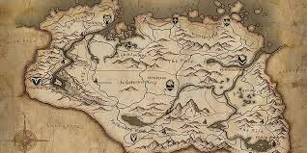
Some questions I wanted to answer:
What is the most common type of weapon?
Is there a correlation between value and damage?
What is the average value of weapons?
What type of weapon causes the most damage?
Do heavier weapons inflict more damage?
Do certain weapon perks cause more damage to be inflicted?

Slide 11
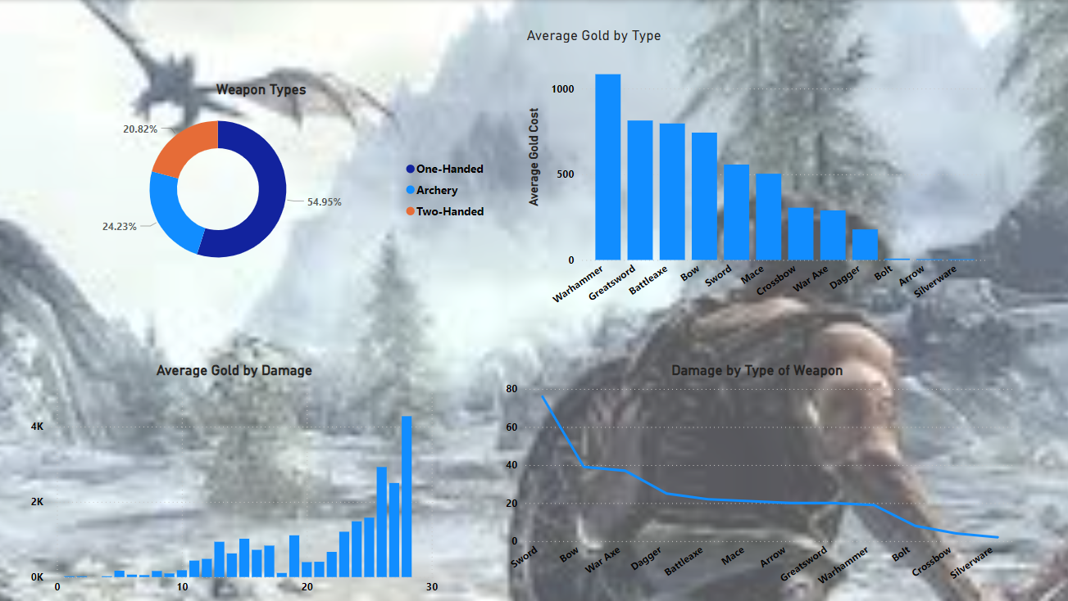

Slide 12
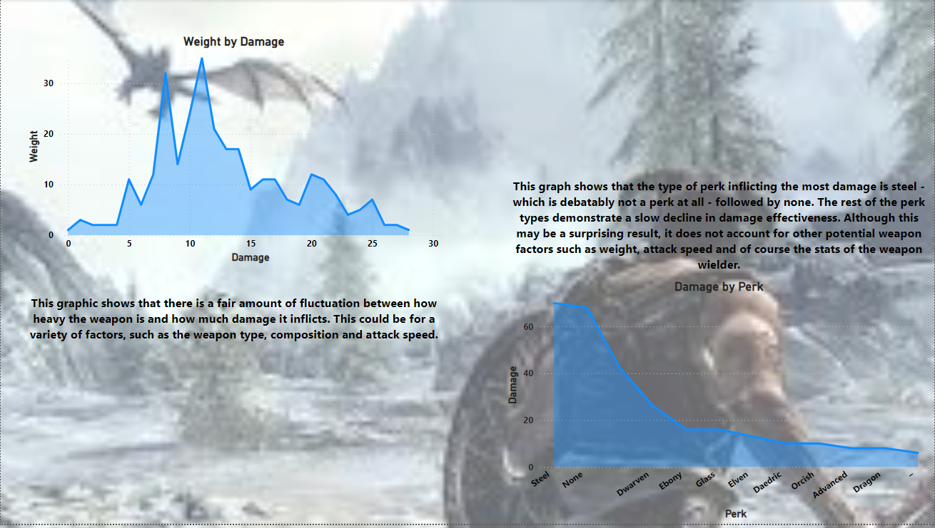

Slide 13
Further analyses
Using Python and MySQL

Slide 14
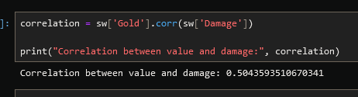
Measuring Correlation in Python

Slide 15
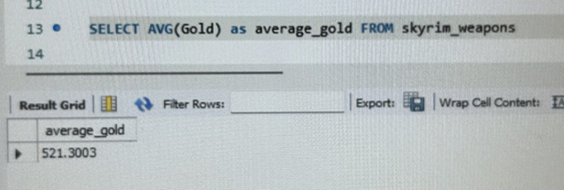
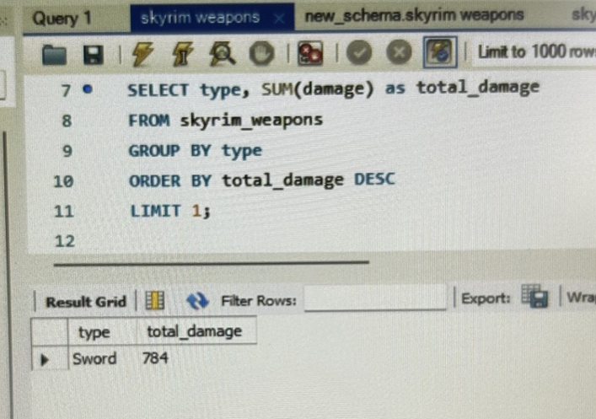
Average gold costs
Highest damage inflicted

Slide 16
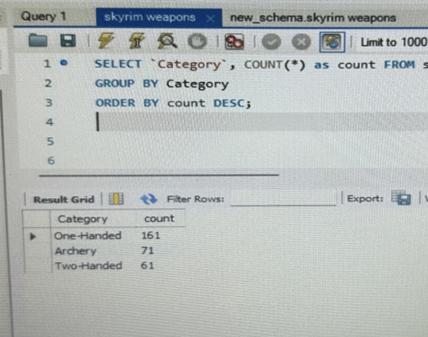
Finding how many weapons of each type are included in the data

Slide 17
Did I answer all of my questions?
What is the most common type of weapon? One-handed.
Is there a correlation between value and damage? Yes.
What is the average value of weapons? 521 Gold
What type of weapon causes the most damage? Sword.
Do heavier weapons inflict more damage? Not necessarily.
Do certain weapon perks cause more damage to be inflicted? No – vanilla weapons inflicted the most.

Slide 18


Summary
This was a brief overview of one of three datasets used in this analysis, using several types of software to demonstrate understanding of different platforms

Slide 19
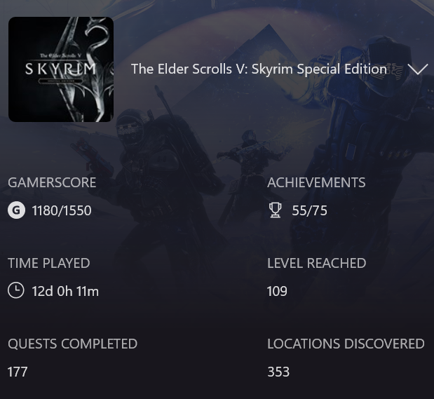
Bonus Stats

Slide 20





Thank you for listening

